Slide 1
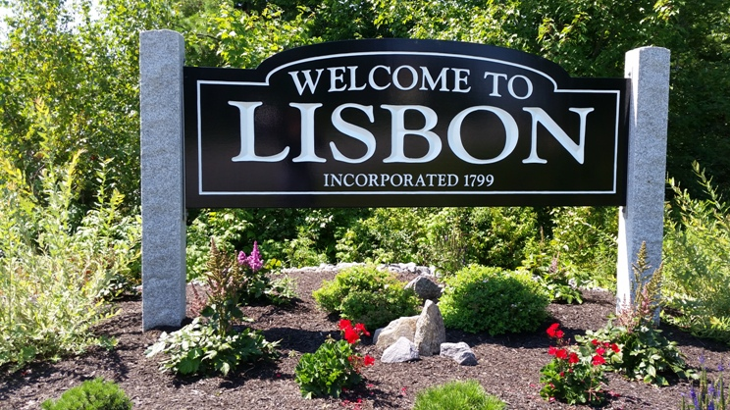
Town of Lisbon
Presentation of the Proposed FY2026 Budget
Glenn Michalowski, Town Manager
Samantha Bryant, Finance Director

Slide 2

Budget Timeframe / Process
School Committee Meeting | School Prepares Draft School Budget & School CIP | Monday February 24, 2025 | 6:00 PM
Special Council Meeting/School Budget Presentation | School Committee Presents School Budget & School CIP to Council Sec 6.03 ...These budgets shall state separately: (1) Proposed expenditures for current operations during the ensuing fiscal year detailed by offices, departments or agencies in terms of their respective work programs and the method of financing such expenditures; and (2) Proposed capital expenditures for the ensuing fiscal year detailed by offices, departments, or agencies, when practicable, and stating the proposed method of financing each such capital expenditure. Sec 86-5... a) The school department shall submit the school budget for consideration broken down into specific amounts for the following categories of costs for each department or agency within the school department: 1) Personnel Services, 2) Contractual, 3) Commodities, 4) Debt Services, 5) Capital Expenditures, & 6) Statutory cost collection data/costs to comply w/state or federal manndatory requests (itemized). | Tuesday March 11, 2025 | 6:00 PM
Council Meeting | Town Manager Introduce Municipal Budget Sec. 6.02...On or before the third Tuesday of March each year, the Town Manager and the School Committee shall submit to the Town Council line item budgets for the ensuing fiscal year. The budget messages accompanying the budgets shall explain the respective budgets both in fiscal terms and in terms of programs. They shall outline the proposed financial policies for the Town and the School Department respectively for the ensuing fiscal year, describe the important features of the respective budgets, indicate any major changes from the current year with respect to financial policies, expenditures, and revenues, and the reasons for the same, summarize the debt position of the Town and School Department respectively, and include such other information as the Town Manager and the School Committee believe to be desirable. Sec 3.02...e) The Manager shall prepare and submit the annual budget, the annual capital program and annual financial and administrative reports to the Council ... | Tuesday March 18,2025 | 6:00 PM
Council Workshops | • Debt Service • Special Revenues • Finance • Clerk • Assessing • Library | Tuesday, March 18, 2025 | 6:00 PM

Slide 3
Budget Timeframe / Process
Council Workshops | • Other Public Services • Western Maine Transportation • Lisbon EMS • Public Works • Solid Waste • Economic and Community Development • Code Enforcement and Planning | Tuesday, March 25, 2025 | 6:00 PM
Council Workshops | • Fire • Police • Parks & Recreation | Tuesday, April 1, 2025 | 6:00 PM
Special Council Meeting | School Request to Set Election Dates (June 4th) for School Budget & School CIP Public Hearings for April 30th and approve Election Warrant | Tuesday April 1, 2025 | 7:00 PM
School Dept Sends 2 Ad Requests to the Sun Journal | School Department Sends School Budget Public Hearing Ad to Sun Journal Thursday to proof by Friday Deadline at 10 AM. First Ad Runs on April 06 per Sec 6.04 (a) 1 & 2 ...The Town Council shall publish in one or more newspapers having general circulation in the Town a general summary of the budgets and a notice stating: 1. The times and places where copies of the budget messages and the budgets will be available to the public, and 2. The time and place (not less than two weeks after the first such publication) of a public hearing on the proposed budgets. Sec 6.08 d) 1... The Town Council shall publish in one or more newspapers having general circulation in the Town a general summary of the capital program and a notice stating: i)The times and places where copies of the capital program will be available to the public; and ii)The time and place, not less than two weeks after the first date of publication, for a public hearing on the capital program. NOTE: Send request for second ad at the same time. | Thursday April 3, 2025 | 10:00 AM
1st School Budget Public Hearing Ad Runs | First Ad for School Budget & School CIP Budget Public Hearings appears in Sun Journal | Sunday April 6, 2025
Council Workshops | •Sewer •Town Manager •Technology •Buildings • Any Other Unaddressed Items | Tuesday, April 8, 2025 | 6:00 PM

Slide 4
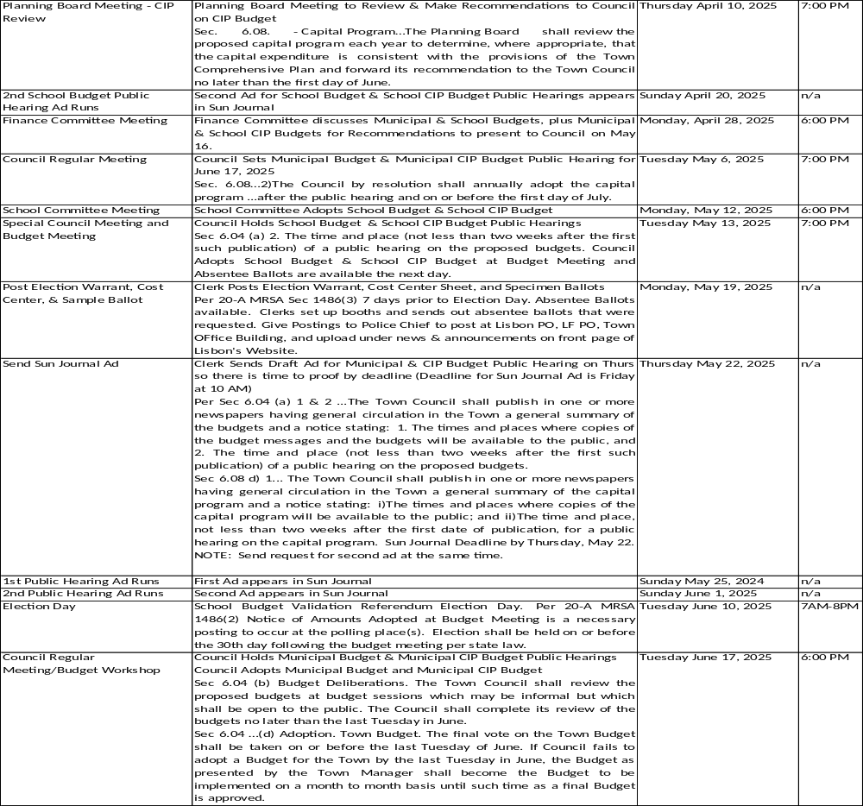
Budget Timeframe / Process

Slide 5
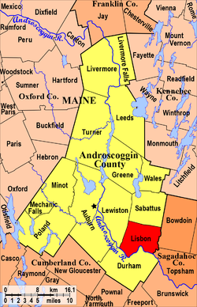
About the Town of Lisbon
The Town of Lisbon is the third largest municipality in Androscoggin County
Out of 492 Maine municipalities, Lisbon is the 23rd largest
Based on the Census data from April 1, 2020:
  Population of 9,711
    Highest population since the Town was incorporated
  This is the amount used for the population component of state shared revenue
Building Permits and other data since 4/1/20 indicate Town population is now well past 10,000 people;
Notes:
The 2020 Census is showing a growth of 702 people for a total population of 9,711; 3,728 households. Some other interesting statistics from the 2020 Census are as follows: the median age is 38.9; 14.6%, or 987 of the population are veterans; 8.5% persons below the poverty line; the average travel time to work is 26.6 minutes for residents of our Town, where 2% of the residents work from home.; the median value of owner-occupied housing units for valuation purposes is $150,700; and the median household income is $57,568 which is about 10% higher than the median household income for Androscoggin County.

Slide 6










Town Services
Public Safety
  Fire Department
  Police/ACO
  Communication Center
  Ambulatory Services
  Transfer Station
  Library
    Programs offered for all ages
    Summer Reading Programs
  Parks & Recreation
    Summer Camp programs
    Sports Camps
    Before and After School
    Senior Programs
    Beaver Park (300 acre park with beautiful trails and ponds)
    Trips for Seniors and Children
Winter Operations
  Plowing
  Public Works
  Road Repairs
  Economic Development
  DARE
    School Resource Officer
  General Assistance
    Giving Tree – Christmas
    Thanksgiving Dinner
  Sewer Department
  Tax Collection
    Motor Vehicle Registration
  Code Enforcement
  Clerk
  Assessing
  Finance
  Town Manager

Slide 7
Budget Components
The FY26 Budget is comprised of four components, the General Fund, Sewer Fund, Capital Fund, and Special Revenues/Reserves Fund.
  General - This is the largest fund in the Town, and it is the one where revenues and expenses not legally obligated to a specific purpose reside. The proposed Managerial FY 2026 Municipal Budget is showing the projected expenditures and revenues on an Organizational Level. Each Organizational level generally represents a department within the Town of Lisbon.
  Sewer Fund – This is an “enterprise” fund, and consists solely of the revenues and expenses related to providing sewer conveyance and treatment services.
  Capital Fund – This fund shows the expenses and revenues related to Town capital expenses. A capital expense is a purchase of $25,000 or greater (whether single or aggregate) that has a useful life greater than one year per Town Charter.
  Special Revenues/Reserves Fund – This houses money from the other funds set aside for a singular purpose. Revenues and expenses generally do not directly go into this fund, but instead transfers between the other funds run through here.

Slide 8

FY26 Budget Structure Changes
Chart of Accounts Update
  It was intended that in FY25 we would have an updated chart of accounts that better reflects the State of Maine Recommend Municipal Chart of Accounts. This project is still ongoing.
Project Accounting
  Capital projects and special revenues/reserves now make use of project accounting
Departmental Expense Allocations
  A handful of accounts were moved to different departments. When comparing numbers from fy24 to fy25 to fy26, the figures have been adjusted for these changes to keep the comparison applicable.

Slide 9
FY25 Budget Errors
There were some items budgeted in FY24 that were not properly budgeted for FY25.
Most notably the wrong amounts smaller than intended were input by Finance for the Police Department for FICA and MEPERS. Due to staffing vacancies and other efforts by the Police Chief, the Police Department will not go overbudget in FY25 despite this mistake.
In addition, in the transition between PW Directors during budget season, the wrong staffing count was used that underbudgeted for staffing. This will not affect FY25 as these positions went unfilled, but need to be funded for FY26 to maintain necessary minimum staffing.

Slide 10
FY25 Budget Tax Rate
In FY25, Council approved using $1.8 million in fund balance to mitigate a tax increase.
However, another ~$1 million in revenue was also double counted on the tax rate form, as the figures for gross revenue and net expenses were used.
Instead of an expected budgeted, there is instead a budgeted deficit.
Due to unsustainable unfilled position vacancies, deferred capital costs, and staff actions, it is expected that FY25 will not actually end in a deficit.

Slide 11
FY25 Budget Performance as of 2/28/25
Row Labels | Sum of 2025 Revised Budget | Sum of 2025 Current
Animal Control | $142,408.12 | $40,636.66
Appeals Board | $1,151.25 | $1,236.14
Assessor | $130,994.06 | $97,250.83
Buildings | $308,500.74 | $186,802.71
Clerk | $177,861.63 | $121,926.65
Code Enforcement | $207,689.90 | $51,056.04
Community Services | $51,083.33 | $30,000.00
County | $1,019,083.00 | $1,022,108.48
Debt | $718,360.30 | $550,535.96
Econ Dev | $140,358.00 | $91,531.16
Elected Officials | $34,598.48 | $15,021.00
EMA | $0.00 | $0.00
Emergency Medical Services | $534,995.86 | $400,725.56
Finance | $612,690.04 | $336,154.41
Fire | $1,117,267.89 | $597,714.56
GA | $91,200.86 | $7,522.58
Hydrants | $557,742.50 | $420,398.75
Insurance | $111,983.00 | $93,575.52
Legal | $70,000.00 | $53,317.80
Library | $428,498.81 | $261,960.89
Lisbon Communications Center | $391,218.04 | $228,488.72
Parks and Rec | $743,150.50 | $429,696.29
Planning Board | $8,289.70 | $17,016.04
Police | $2,362,783.38 | $1,374,198.56
Public Works | $2,190,537.31 | $630,685.96
School | $8,277,313.00 | $5,518,208.64
Solid Waste | $502,213.37 | $167,007.92
Streetlights | $102,680.09 | $44,666.42
Technology | $302,205.10 | $326,455.28
TIF | $273,835.12 | $48,305.86
Town Manager | $427,431.08 | $306,555.04
Treasury | ($21,912,256.19) | ($17,975,868.06)
Winter | $462,232.28 | $138,999.01
Grand Total | $588,100.55 | ($4,366,108.62)
Notes:
Despite the setbacks of fy25 and the mistakes made by the Finance Director in creation of the fy25 budget, we will not need to use additional fund balance beyond the $1.8 million authorized to avoid a deficit. This was achieved due to staffing vacancies, deferment of capital costs, and other staff actions. However, those efforts are unsustainable.

Slide 12
Council Goals and Budget Impacts
Collaborate with other stakeholders to consolidate services and improve efficiency.
1
Reduction in HR expenses
Take significant steps towards a new public safety building and emergency service improvements.
2
PS Building engineering/design
24/7 Fire Department
Enhance staff leadership development
3
Trainings
Establish a Charter Commission to review and update the town charter.
4
Negligible impact to legal expenses in FY26
Improve public communications, including better engagement and transparency.
5
Website upgrade
Online payment options
IT improvements
Replacement of 2 FT positions replaced with 1 FT shared between two departments
Notes:
This list is not intended to be comprehensive, just hitting some major high points.

Slide 13
General Fund
FY26 Budget vs FY25 Budget Expenses
Row Labels | Sum of 2025 Revised Budget | Sum of 2026 Manager Budget | Sum of fy25 to fy26
Animal Control | $142,408.12 | $95,082.57 | -$47,325.55
Appeals Board | $1,151.25 | $89.00 | -$1,062.25
Assessor | $130,994.06 | $106,072.37 | -$24,921.69
Buildings | $310,554.18 | $346,234.35 | $35,680.17
Clerk | $177,861.63 | $217,868.87 | $40,007.24
Code Enforcement | $207,689.90 | $340,098.19 | $132,408.29
Community Services | $51,083.33 | $54,800.00 | $3,716.67
County | $1,019,083.00 | $1,217,024.90 | $197,941.90
Debt | $718,360.30 | $939,968.96 | $221,608.66
Econ Dev | $65,387.08 | $145,216.00 | $79,828.92
Elected Officials | $39,598.48 | $33,623.60 | -$5,974.88
EMA | $0.00 | $6,032.00 | $6,032.00
Emergency Medical Services | $534,995.86 | $567,373.05 | $32,377.19
Finance | $612,690.04 | $647,066.50 | $34,376.46
Fire | $1,117,087.56 | $1,702,512.25 | $585,424.69
GA | $91,200.86 | $71,051.25 | -$20,149.61
Hydrants | $557,742.50 | $640,000.00 | $82,257.50
Insurance | $111,983.00 | $117,831.30 | $5,848.30
Legal | $70,000.00 | $70,000.00 | $0.00
Library | $428,498.81 | $583,150.05 | $154,651.24
Lisbon Communications Center | $391,218.04 | $444,166.78 | $52,948.74
Parks and Rec | $666,150.50 | $696,215.97 | $30,065.47
Planning Board | $8,289.70 | $3,403.30 | -$4,886.40
Police | $2,421,970.48 | $2,748,218.84 | $326,248.36
Public Works | $2,195,537.31 | $2,927,986.15 | $732,448.84
School | $8,277,313.00 | $8,948,132.00 | $670,819.00
Solid Waste | $502,213.37 | $597,366.00 | $95,152.63
Streetlights | $102,680.09 | $80,000.00 | -$22,680.09
Technology | $334,032.10 | $358,237.00 | $24,204.90
TIF | $273,835.12 | $500,000.00 | $226,164.88
Town Manager | $427,431.08 | $573,486.18 | $146,055.10
Winter | $462,232.28 | $456,677.50 | -$5,554.78
Grand Total | $22,451,273.03 | $26,234,984.93 | $3,783,711.90
Notes:
Departmental expenses will be discussed in detail at the upcoming workshops.

Slide 14
FY26 General Fund Expenses Departmental Comparison
Notes:
The usual suspects are the largest slice of the pie, with public works, police, fire, and parks/rec being the “Big Four” for the town totaling 30% of the budget. Though an increased fire and flat parks/rec make it more of a “Big Three” nowadays. The town itself does not do the budget for the school or county, which make up 39% of fy26 expenses. Payments to the Lisbon Water Department and Lisbon Emergency Medical Services increase that share to 44%.

Slide 15
General Fund Non Tax Revenues
FY26 Budget vs FY25 Budget
Department | Organization | Object | GL Account | Account Description | 2026 Manager Budget | 2025 Revised Budget
Treasury | 12020000 | 40002 | 12020000-40002 | In lieu of property taxes | ($10,000.00) | ($9,500.00)
Treasury | 12020000 | 40004 | 12020000-40004 | Supplmental Real & Prop Taxes | ($10,000.00) | ($11,000.00)
Treasury | 12020000 | 40020 | 12020000-40020 | Motor vehicle excise taxes | ($1,900,000.00) | ($1,900,000.00)
Treasury | 12020000 | 40021 | 12020000-40021 | Boat excise taxes | ($7,000.00) | ($7,000.00)
Treasury | 12020000 | 40030 | 12020000-40030 | Interest/Penalties on Taxes | ($28,000.00) | ($36,000.00)
Treasury | 12020000 | 40160 | 12020000-40160 | Agent Fees | ($43,000.00) | ($45,000.00)
Treasury | 12020000 | 40226 | 12020000-40226 | State revenue sharing | ($2,371,054.57) | ($2,485,702.37)
Treasury | 12020000 | 40227 | 12020000-40227 | Urban road initiative program | $0.00 | ($102,000.00)
Treasury | 12020000 | 40231 | 12020000-40231 | Veterans Reimbursement | ($15,000.00) | ($10,000.00)
Treasury | 12020000 | 40232 | 12020000-40232 | Tree Growth Reimbursement | ($15,000.00) | ($17,000.00)
Treasury | 12020000 | 40235 | 12020000-40235 | State Road Revenue | $0.00 | ($21,500.00)
Treasury | 12020000 | 40260 | 12020000-40260 | Fax Revenue | ($10.00) | $0.00
Treasury | 12020000 | 40261 | 12020000-40261 | Copier Revenue | ($100.00) | $0.00
Treasury | 12020000 | 40901 | 12020000-40901 | Sewer Dept Admin Reimbursement | ($28,238.77) | ($21,364.66)
Treasury | 12020000 | 40902 | 12020000-40902 | Sewer Dept Benefit Reimburseme | $0.00 | ($4,976.20)
Treasury | 12020000 | 40903 | 12020000-40903 | Water Dept Admin Reimbursement | ($17,530.49) | ($14,995.21)
Treasury | 12020000 | 40904 | 12020000-40904 | Water Dept Benefit Reimburseme | $0.00 | ($4,482.15)
Treasury | 12020000 | 40905 | 12020000-40905 | Water Dept IT Reimbursement | ($2,000.00) | ($5,000.00)
Treasury | 12020000 | 40906 | 12020000-40906 | Water Dept Insur Reimbursement | $0.00 | $0.00
Treasury | 12020000 | 40991 | 12020000-40991 | Misc Revenue | ($4,000.00) | ($1,801,500.00)
Treasury | 12020000 | 40992 | 12020000-40992 | WC Insurance Dividend | ($18,000.00) | ($18,000.00)
Treasury | 12020000 | 40993 | 12020000-40993 | Unemployment Dividend | ($6,000.00) | ($6,000.00)
Treasury | 12020000 | 44409 | 12020000-44409 | Investment earnings | ($300,000.00) | ($308,220.07)
Treasury | 12020000 | 48033 | 12020000-48033 | Insurance Claim Revenue | ($5,000.00) | ($5,000.00)
Treasury | 12090100 | 50901 | 12090100-50901 | Tax abatements | $5,000.00 | $5,000.00
Notes:
General trend for fy26 is that revenues not affected by the mil rate (real and personal property, homestead exemption, bete exemption) are flat or lower compared to fy25

Slide 16
Budget Challenge – Revenue Generation
Because of the revenue miscalculations and budget errors from FY25 and new expenses to meet Council goals and external payments, the Town would need $21.5 million in tax revenue.
This would be a 45% tax increase from FY25, and thus will not happen.
A tax increase will still be needed, but not at the level currently proposed. Instead, the Town will need to work through various spending reductions from those planned for FY26. These reductions would include a freeze on merit pay increases, a hiring freeze, withdrawing the proposal for the Town to pay 100% of employee dental benefits, and a deferment of capital and other one time expenditures. Some use of fund balance may still be necessary as well to get through FY26.

Slide 17
Capital Improvement Plan
The Capital Improvement Plan (CIP) provides a long term roadmap for Town capital expenditures so that the Town can plan in advance for how to pay for them.
Capital expenditures are defined as any item that costs more than $25,000 (on its own or in aggregate) AND has a useful life greater than one year.
This plan is presented on a 5 year model per Town Charter.
In addition to the 5 year plan forecasts, this report includes estimated annual cost of operating and maintaining vehicles and equipment, as well as the current mileage of those vehicles.

Slide 18
FY26 CIP Highlights
Fire Truck (already ordered and approved from nov 2022 debt referendum)
Police Vehicles (paid from special reserve funds contributed in prior year)
Beaver Park Cabin Roof (deferred from prior years)
Replacement of outdated police tasers
Burrough Rd Bridge (funded by federal grant and previously approved nov 2024 debt referendum)
Maple St paving
General road maintenance
Transfer Station attendant building heater
Sewer pump station replacement (paid from sewer fees)
Parks/Rec bus replacement

Slide 19
Town of Lisbon Summary – 5 Year CIP
Department | Account Description | 2026 Manager Budget | 2027 Manager Budget | 2028 Manager Budget | 2029 Manager Budget | 2030 Manager Budget
Parks/Rec | Capital - Parks/Rec Buildings | $20,000.00 | $41,000.00 | $0.00 | $0.00 | $0.00
Parks/Rec | Capital - Parks/Rec Land Impro | $0.00 | $0.00 | $0.00 | $0.00 | $0.00
Solid Waste | Capital - Solid Waste Equipmen | $0.00 | $0.00 | $0.00 | $0.00 | $0.00
ACO | Capital - ACO Vehicle | $0.00 | $0.00 | $0.00 | $0.00 | $0.00
ACO | Capital - ACO Vehicle Equipmnt | $0.00 | $0.00 | $0.00 | $0.00 | $0.00
Comm Center | Capital - Comm Center Equipmen | $0.00 | $0.00 | $220,000.00 | $270,000.00 | $0.00
Parks/Rec | Capital - Parks/Rec Equipmnt | $0.00 | $35,000.00 | $0.00 | $0.00 | $0.00
Police | Capital - Police Vehicles | $122,666.67 | $61,333.33 | $122,666.67 | $61,333.33 | $122,666.67
Police | Capital - Police Equipment | $19,000.00 | $37,000.00 | $19,000.00 | $19,000.00 | $31,950.00
Public Works | Capital - PW Vehicles | $238,500.00 | $155,000.00 | $210,000.00 | $0.00 | $0.00
Public Works | Capital - PW Infrastructure | $2,595,000.00 | $500,000.00 | $500,000.00 | $1,000,000.00 | $500,000.00
Public Works | Capital - PW Equipment | $0.00 | $325,000.00 | $0.00 | $0.00 | $0.00
Fire | Capital - Fire - Vehicles | $1,002,013.00 | $69,500.00 | $2,000,000.00 | $350,000.00 | $0.00
Fire | Capital - Fire Equipment | $0.00 | $0.00 | $350,000.00 | $0.00 | $0.00
Parks/Rec | Capital - Parks/Rec Vehicles | $50,000.00 | $85,000.00 | $0.00 | $0.00 | $0.00
Town | Capital - Town Buildings | $25,000.00 | $14,605,000.00 | $0.00 | $30,000.00 | $0.00
Town | Capital - Technology | $0.00 | $20,900.00 | $0.00 | $0.00 | $0.00
Sewer | Capital - WWTP Vehicles | $0.00 | $0.00 | $0.00 | $0.00 | $0.00
Sewer | Capital - WWTP Equipment | $150,000.00 | $150,000.00 | $120,000.00 | $600,000.00 | $60,000.00

Slide 20
CIP Funding Sources
Department | Account Description | 2026 Manager Budget | 2027 Manager Budget | 2028 Manager Budget | 2029 Manager Budget | 2030 Manager Budget
Grants - PW | Federal capital grants | ($950,000.00) | $0.00 | $0.00 | $0.00 | $0.00
Taxes | Other intergovernmental revenu | ($1,267,500.00) | ($1,268,400.00) | ($1,299,000.00) | ($1,669,000.00) | ($591,950.00)
Debt - Fire | Other Bonds Issued | ($1,002,013.00) | $0.00 | ($2,000,000.00) | $0.00 | $0.00
Debt - PW | Other Bonds Issued | ($730,000.00) | $0.00 | $0.00 | $0.00 | $0.00
Debt - Sewer | Other Bonds Issued | $0.00 | $0.00 | $0.00 | ($600,000.00) | $0.00
Debt - Town | Other Bonds Issued | $0.00 | ($14,605,000.00) | $0.00 | $0.00 | $0.00
Sewer Fees | Capital contributions | ($150,000.00) | ($150,000.00) | ($120,000.00) | $0.00 | $0.00
Special Reserve - Police | Police Cruiser Revenue | ($122,666.67) | ($61,333.33) | ($122,666.67) | ($61,333.33) | ($122,666.67)

Slide 21

Debt
Per GFOA:
Utilizing municipal bonds and other types of debt (including bank loans and lines of credit) to fund public infrastructure is a valuable strategy for Governments to spread the cost of significant long-term assets over their useful life. It is important to involve all stakeholders in the decision to issue debt and to make sure resources are identified to prepare for the issuance of debt and to address on-going requirements throughout its term.

Slide 22
Debt Limits
Per FY23 Audit “In Maine, a municipality may not incur debt which would cause its total debt outstanding at any time, exclusive of debt incurred for school purposes, for storm or sanitary sewer purposes, for energy facility purposes or for municipal airport purposes to exceed 7 1/2% of its last full state valuation or any lower percentage or amount that the citizens of the Town may set by Charter or Ordinance. A municipality may incur debt for school purposes to an amount outstanding at any time not exceeding 10% of its last full state valuation or any lower percentage or amount that a municipality may set, for storm or sanitary sewer purposes to an amount outstanding at any time not exceeding 7 1/2% of its last full state valuation or any lower percentage or amount that the citizens of the Town may set by Charter or Municipal Ordinance. Municipalities may set for municipal airport and special district purposes an amount outstanding at any time not exceeding 3% of its last full state valuation or any lower percentage or amount that a municipality may set. However, in no case may a municipality incur debt which would cause its total debt outstanding at any time to exceed 15% of its last full state valuation or any lower percentage or amount that a municipality self-imposes. However, the Town has a self-imposed debt limit of 5% of the assessed value of taxable property in the Town ($xxxxxxxxxx). Per the Town’s revenue policy, long term debt will only be used to finance long-lived capital and operating assets.”

Slide 23

Debt Limits as 1/1/25
Current Debt Limit: $51,789,565
Current Applicable Debt Outstanding and Unpaid Plus Authorized but Unissued: $18,449,154
Total Debt Available: $33,340,411
Total Debt Usage in CIP: $17,492,173
Town debt service is 4% of annual expenses in the FY26 Budget.

Slide 24
Debt vs Pay-Go
Pay-Go is a very simple concept—paying for a portion of capital projects with cash as opposed to bonding.
Bonding makes sense when:
  Costs are saved through accelerated construction
  Inflation and preventative maintenance exceed the interest paid on the funds.
  Quantifiable economic benefits exceed the cost of borrowing
  A future identifiable and available revenue source exists to pay for the bonds
  Intergenerational Equity
  Pay-Go funds are not available
Pros of Pay-Go:
  Reduce interest costs associated with bonds.
  Bond interest payments impose a real cost
  Bonding involves moving a future stream of revenues to current use resulting in there being less funds available for other future uses.

Slide 25
Fund Balance Policy
Sec. 86-1. - Fund balance policy.
(a) The Town of Lisbon recognizes the importance of maintaining an appropriate level of undesignated fund balance. The town's unassigned GF fund balance serves a number of stabilizing purposes. It is a surplus of amounts which have accrued from unexpected operating budget surplus and unanticipated excess revenues. The surplus also provides the town with an amount for use in unforeseen, unbudgeted emergency situations, and provides a cash flow cushion to offset the need for borrowing in anticipation of tax receipts.
(b) In order to maintain financial stability, the town has established this policy to maintain an unassigned GF fund balance no less than 12% and no more than 16% of the current fiscal year's budget as defined below:
Gross town operating budget, including town's share of school budget, town's portion of the county's operating budget, and debt service.
(c) Once the town achieves its goal of an appropriate level of undesignated fund balance, any excess funds may be utilized for other municipal purposes, including, without limitation, additional capital improvement needs, tax rate stabilization, or reduction purposes. For example, by utilizing excess fund balances for capital improvements, the town will reduce the need to incur long-term debt and will avoid creating an operating funding gap for subsequent fiscal years.
(d) This policy has been adopted by the town to recognize the financial importance of a stable and sufficient level of undesignated fund balance. However, the town, reserves the right to appropriate funds from the undesignated fund balance for emergencies and other requirements the town believes to be in the best interest of the town.
(e) In the event the town's undesignated fund balance drops below the 12% minimum, a written plan to replenish the fund within a maximum of three fiscal years must be approved by the town council at the time of the emergency GF fund balance appropriation.
(Sel. Ord. of 2-7-2006, § 5.166; C.M. of 3-7-2017, V. 2017-51 )

Slide 26
Fund Balance for FY26 Budget
Until the FY24 Audit is completed (expected by end of March), fund balance is unknown but expected to be within the required 12% to 16%.
Part of the thought process in FY25 was to use excess fund balance and then end the practice of using fund balance to mitigate taxes. It is not recommended to use fund balance going forward for this purpose.

Slide 27
Sewer Fund
Current Sewer rate | $ 9.00 | per 100cf
5% Rate Increase | $9.45 | per 100cf
MEI Current Rate | $ 3.02 | per 100cf
5% Rate Increase | $ 3.17 | per 100cf
Septic Current | $ 0.160 | per gallon
6% Increase | $ 0.170 | per gallon
Holding Current | $ 0.08 | per gallon
No Increase
Total Proposed Revenues: $1,800,319
  Includes proposed fee increases per 2017 fee plan
  Current sewer fund balance is $1,835,461 million with $55,494 being used for fy26, and $885,923 in fy25 per 2017 fee plan
    Fund balance is not to be used for budget balancing after fy26
Total Proposed Expenses: $1,800,319

Slide 28
Special Revenues and Reserves Fund
Special revenues and reserves are either revenues the Town has received that must be used for a specific purpose (such as grants or donations), or money set aside for a specific use (such as saving up for a capital project)
Work is still ongoing to validate the balances and purposes of these funds, due to these efforts, no official budget for these funds will be provided for FY26

Slide 29
Questions?

