Slide 1
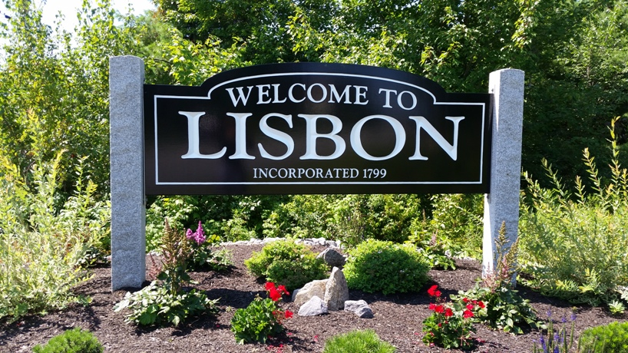
Town of Lisbon
Presentation of the Capital Improvement Plan FY22
Kayla Tierney, Finance Director
March 23, 2021

Slide 2
Introduction
The Capital Improvement Plan (CIP) is a document that focuses on the implementation of community goals through detailed recommendations on capital spending and needs for the current and forecasted future fiscal years.
The CIP to be submitted to the Council is to be broken down by Town, presented here on a departmental level; by School Department; and lastly by the Water Department.
This plan is presented on a 5 year module and on a 10 year module.
Notes:
The additional 5 years as it is presented in the 10 year module will be a reflection of what to expect in the upcoming years as we focus on a best practice for asset retention, replacement and overall maintenance of our capital items.

Slide 3
About the Plan
The CIP demonstrates specific projects, amounts of those projects, and the sources of funding for those projects.
This document is a framework for making the best use of financial resources.
Within the CIP report, a section of footnotes follows immediately after each department’s requests. These footnotes go into more depth about the capital items being requested in the upcoming fiscal year.
In addition to the 5 and 10 year plan forecasts, this report includes estimated annual cost of operating and maintaining vehicles and equipment, as well as the current mileage of those vehicles.
The Debt Structure (Bonds and Leases) is also included in this report.
Each department has submitted their requests for capital needs.
Notes:
By understanding the maintenance costs, it allows us to identify which assets are to be maintained and which ones are to be earmarked for replacement.
To support the amounts of the projects and the sources of funding, it is imperative that the Town also include the Debt Structure to assist in making the best decision for the use of the financial resources.
Each department provides their requests to the Town Manager and the Finance Director before the end of the calendar year. Each department’s requests are then reviewed and evaluated based on needs, financial capacity and the overall impact it may or may not have on the Town’s operating budget – this process is as follows: The Town Manager recommends to the Planning Board and the Town Council the selection and timing of capital projects into future fiscal years. First year projects are incorporated into the Town’ Manager’s recommended annual operating budget or recommended through other funding sources such as Unassigned Fund Balance.

Slide 4
What is a Capital Improvement?
Per the Capital Improvement Plan Program Policy:
  It is a major fiscal expenditure which is made infrequently or which is not-recurring and includes one or more of the following:
    Acquisition of Land;
    Construction or expansion of a public facility, street, or utility;
    Non-recurring rehabilitation or construction of an asset provided the cost is more than $25,000 and extends the useful life of the asset;
    Design or Programming related to an individual project; or
    Any item or piece of equipment that will be bonded or budgeted in more than one fiscal year.
  It also includes assets that would hold a useful life of 5 years or longer and includes machinery, equipment or vehicles that are greater than or equal to $10,000. These may be one time purchases or recurring based on the established useful life of the asset once it is placed into service.

Slide 5
Town of Lisbon CIP
Departmental Level

Slide 6
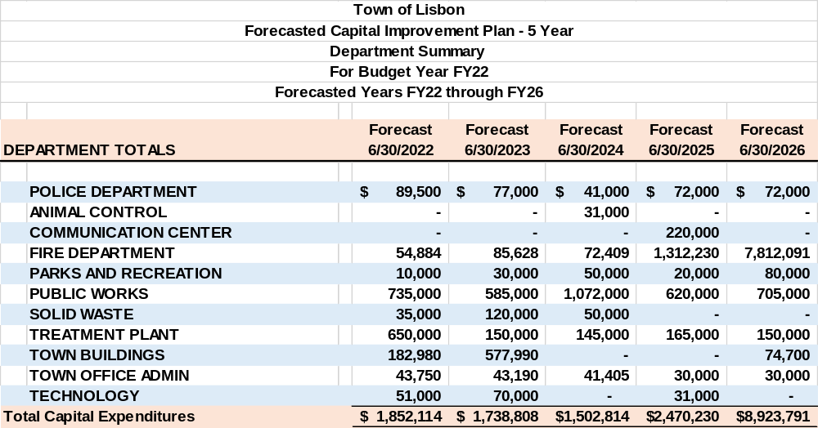
Town of Lisbon Summary – 5 Year CIP

Slide 7
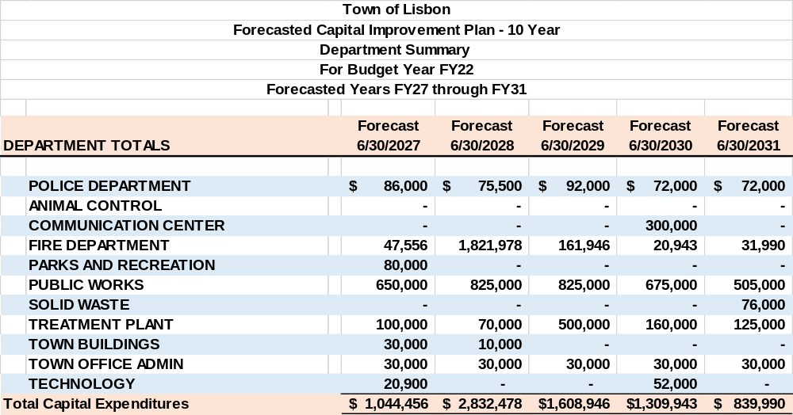
Town of Lisbon Summary – 10 Year CIP

Slide 8
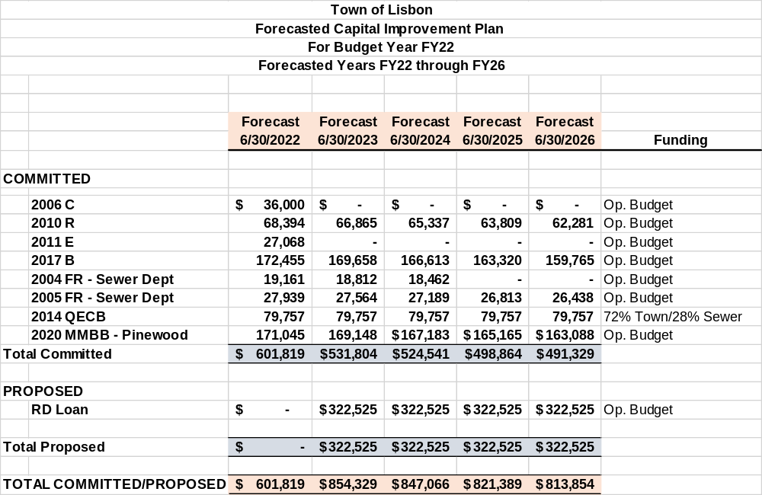
Debt Structure – 5 Year

Slide 9
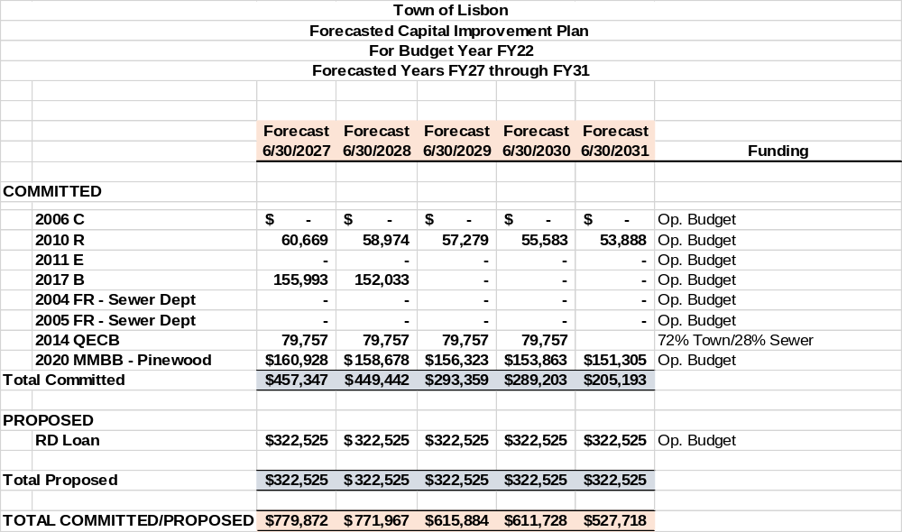
Debt Structure – 10 Year

Slide 10
FY22 CIP Highlights (all departments)
Police:
  (2) Cruisers as part of the cruiser replacement plan ($62,000 Total)
  Bullet proof vests ($14,000)
  Portable Radios ($13,500)
  Cruiser Equipment ($8,000)
  Fire:
    Turnout Gear ($14,884)
    Fire Station Study ($30,000)
    Squad 3 refurbish ($10,000)
  Parks & Rec
    Miller Trail Fence ($10,000)
Public Works:
  New plow truck ($50,000)
  Refurb 2008 plow truck ($15,000)
  20 ton Trailer ($24,000)
  Excavator ($111,000)
  Annual Paving ($475,000)
  Street Light controls x2 ($40,000)
  Guardrails ($10,000)
  Sidewalk paving ($10,000)
  Solid Waste:
    Forklift ($35,000)

Slide 11
FY22 CIP Highlights (cont.)
  Town Buildings
    Library Heating/Cooling pumps ($17,200)
    Re-pitch Roof – Transfer Station ($55,000)
    Generator – PW Garage ($40,000)
    Generator – Lisbon Falls Fire Station ($15,000)
    Generator – ET Smith Fire Station ($15,000)
    Boiler – Lisbon Falls Fire Station ($26,780)
    Electrical Work – Lisbon Falls Fire Station ($14,000)
Town Office Admin:
  Clerk Records Restoration ($13,750)
  Assessing – Revaluation ($30,000)
  Technology:
    Server – Town Office ($19,000)
    Cruiser Laptops – Police ($32,000)
WWTP:
  Ford F-250 ($50,000)
  Isco 5800 Samplers ($15,000)
  Wemco Torque flowpumps ($70,000)
  RACO auto dialers ($15,000)
  Centrifuge ($500,000)

Slide 12
Final Notes
The amounts for CIP for each department coincides with the Department asks (Initial Budget) presented the previous week (3/16/2021).
  The funding source of Op. Budget is a reflection of this.
  The difference between the Initial Budget and the Managerial Budget represents the change in funding source.
    i.e. Unassigned Fund Balance
  Department Heads will be discussing their capital needs further in depth during their individual budget presentations.

Slide 13
Questions?

