Slide 1
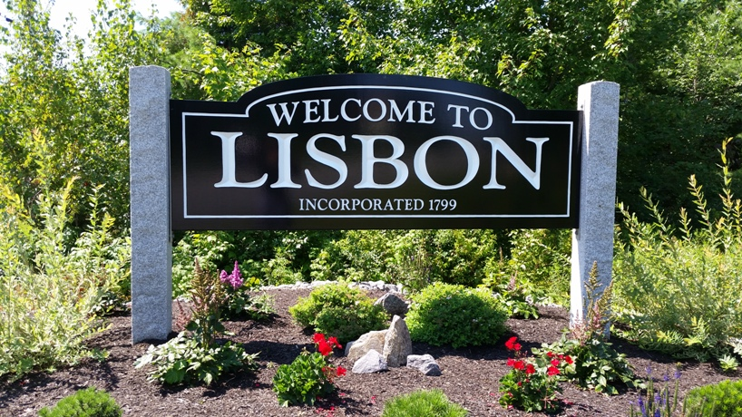
Town of Lisbon
Public Hearing: FY22 Municipal Budget
Diane Barnes, Town Manager
June 22, 2021

Slide 2
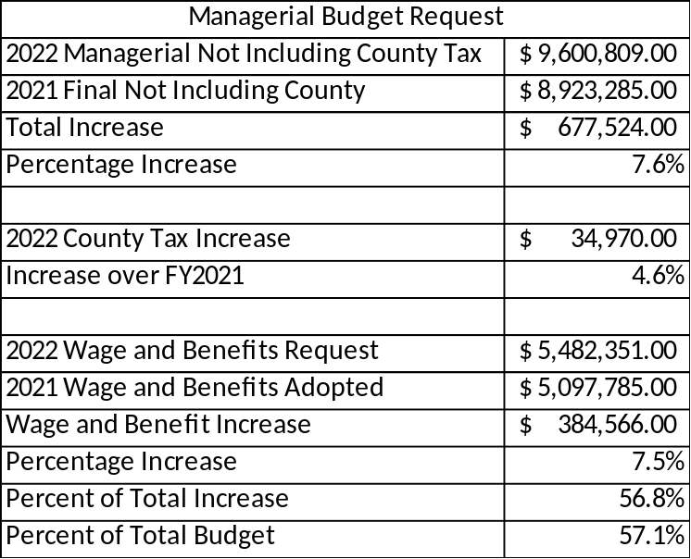
Budget Overview (Managerial)
The March 16, 2021 Managerial FY2022 Municipal Budget request for the General Fund, was a total of $9,600,809.00 (excluding County Tax and local contribution to the School Department.
  Increase of $677,524.00 or 7.6% over the current FY21 budget of approximately $8,923,285.00
  In total, wages and benefits comprise 57.1% of the budget.

Slide 3
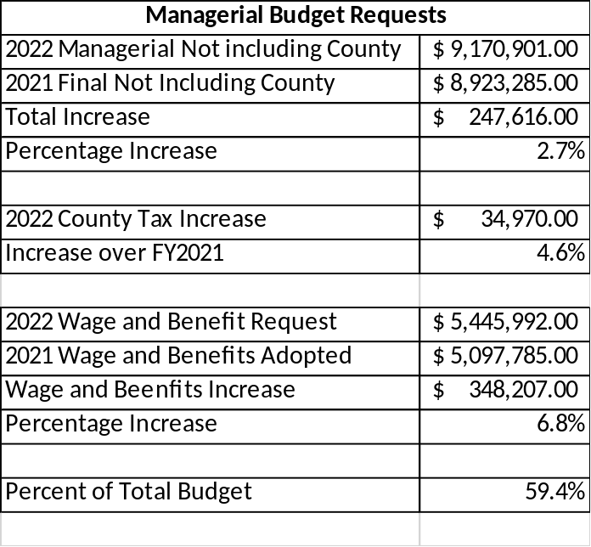
Budget Overview (cont.)
Managerial FY2022 Municipal Budget Request (General Fund, not including County)
  Total of $9,170,901 for an increase of $247,616.00 or 2.7% over the FY21 budget.
    This excludes the County Tax and local contribution to the School Department.
    In total, wages and benefits comprise 59.4% of the budget.
Total budgeted expenditures per the 2021-2022 Municipal Budget Resolution is: $9,974,121.00 (includes County Tax)

Slide 4
Budget Components
The proposed Managerial FY 2022 Municipal Budget is for expenditures on an Organizational Level; Revenues will be at a later date. Each Organizational level includes multiple departments within the Town of Lisbon.
Organizational Levels within the General Fund include:
General Government
Health & Welfare
Public Safety
Public Works
Culture & Recreation
Economic Development
Intergovernmental
Other organizational levels include:
  Debt Service
  Sewer

Slide 5
Budget Comparison
The proposed Managerial Budget, showing a $247,616 or 2.7% increase over the current (FY21) budget.
  The current mil rate (FY21) is $23.10
Covid-19 played a big role in the FY21 Budget process
  In effect, there were positions that were deferred to be filled.
  There were also capital improvements that were held off.
  The FY22 Proposed Managerial Budget reflects the recovery of positions. The need for capital improvement purchases during FY22 will be fulfilled through Unassigned Fund Balance.

Slide 6
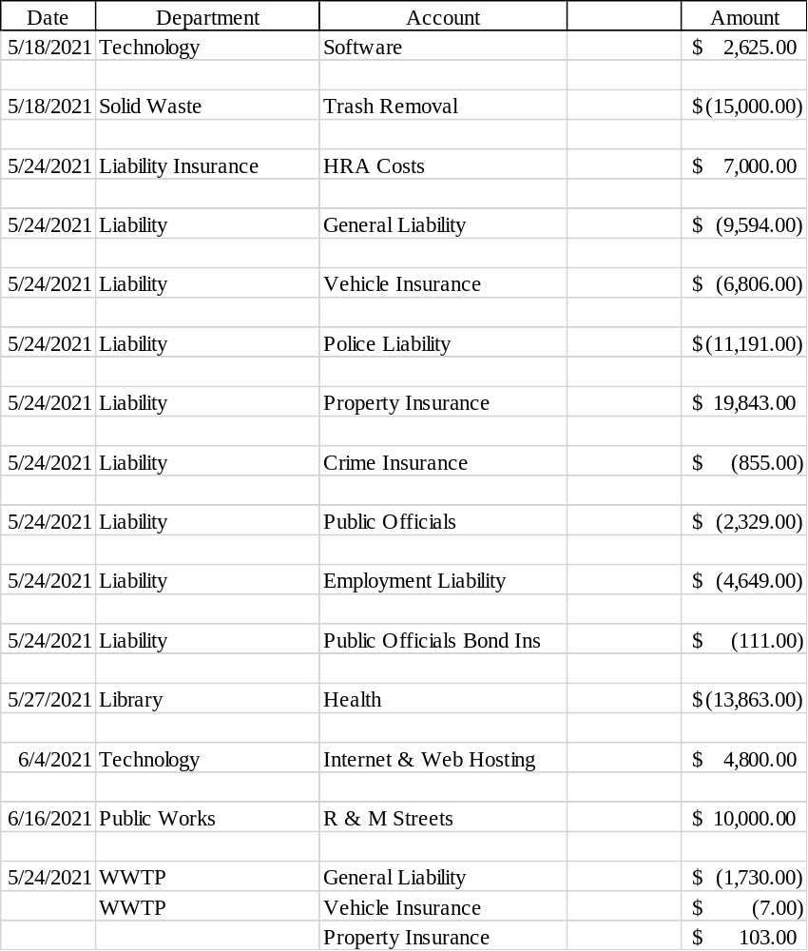
Budget Changes
To the left is a listing of Budget Changes made since the March 16, 2021 budget presentation Council Meeting that reflect the current budget presented here tonight.

Slide 7
Budgeted Revenues
Total FY22 Budgeted Revenue for the General Fund is $4,290,271
  This is a $897,412.00 increase or 26.5% increase from FY21 approved budgeted revenues.
Total FY22 Budgeted Revenue for the Sewer Fund is $1,442,072
  This is a $77,417.00 increase or 5.7% increase from FY21 approved budgeted revenues.
The State Revenue Sharing projections published on the Office of the State Treasurer website as of May 7, 2021 is the amount included in the budgeted revenues above.

Slide 8
Fund Balance Policy
Sec. 86-1. - Fund balance policy.
(a) The Town of Lisbon recognizes the importance of maintaining an appropriate level of undesignated fund balance. The town's unassigned GF fund balance serves a number of stabilizing purposes. It is a surplus of amounts which have accrued from unexpected operating budget surplus and unanticipated excess revenues. The surplus also provides the town with an amount for use in unforeseen, unbudgeted emergency situations, and provides a cash flow cushion to offset the need for borrowing in anticipation of tax receipts.
(b) In order to maintain financial stability, the town has established this policy to maintain an unassigned GF fund balance no less than 12% and no more than 16% of the current fiscal year's budget as defined below:
Gross town operating budget, including town's share of school budget, town's portion of the county's operating budget, and debt service.
(c) Once the town achieves its goal of an appropriate level of undesignated fund balance, any excess funds may be utilized for other municipal purposes, including, without limitation, additional capital improvement needs, tax rate stabilization, or reduction purposes. For example, by utilizing excess fund balances for capital improvements, the town will reduce the need to incur long-term debt and will avoid creating an operating funding gap for subsequent fiscal years.
(d) This policy has been adopted by the town to recognize the financial importance of a stable and sufficient level of undesignated fund balance. However, the town, reserves the right to appropriate funds from the undesignated fund balance for emergencies and other requirements the town believes to be in the best interest of the town.
(e) In the event the town's undesignated fund balance drops below the 12% minimum, a written plan to replenish the fund within a maximum of three fiscal years must be approved by the town council at the time of the emergency GF fund balance appropriation.
(Sel. Ord. of 2-7-2006, § 5.166; C.M. of 3-7-2017, V. 2017-51 )

Slide 9
Unassigned Fund Balance
The Unassigned Fund Balance as of 6/30/2020 (per FY20 final audit) is $3,195,275.00
  13% of GF Operating Budget = $952,760.70
  12% of GF Operating Budget = $1,125,261.80
  An approximate $180,000.00 of Overlay
  $33,000 received for Training Expenses
    It is recommended to use the 12% threshold of Unassigned Fund Balance, in addition to the approximate amount of Overlay and the amount received for training expenses for non-recurring capital costs that were deferred in FY21.

Slide 10
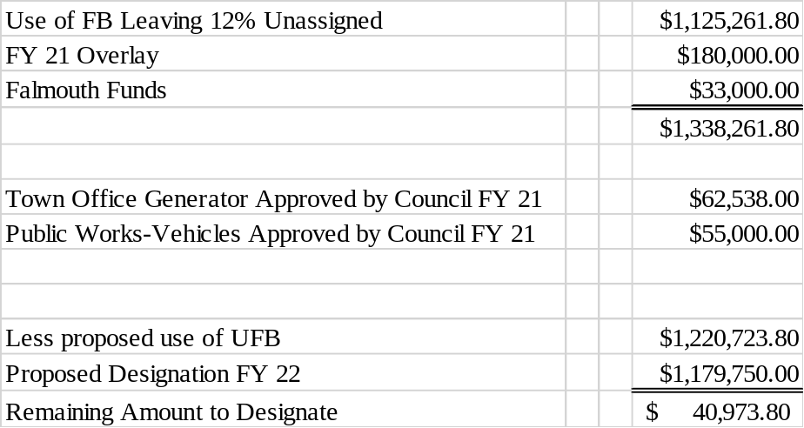
Unassigned Fund Balance (cont.)
FY21 USE OF FB approved by Council:
Town Office Generator $62,538.00
Public Works – Vehicle
$55,000.00
See Proposed Designation FY22 items on next slide

Slide 11
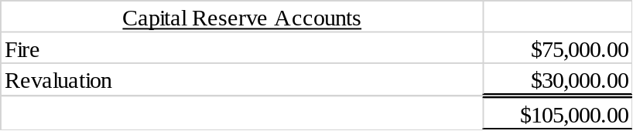
Unassigned Fund Balance (cont.)
Proposed Designation FY22
  Total Capital Improvements (left) $1,074,750.00 plus the total Capital Reserve Accounts (below) of $105,000.00 equals $1,179,750.00
Town Clerk
$13,750.00
Clerk Book Restoration
Technology Budget
$35,800.00
Server & Hardware Upgrades
Technology Budget
$32,000.00
Cruiser Laptops
Town Buildings
$15,000.00
LFD Generator
Town Buildings
$15,000.00
ET Smith Generator
Town Buildings
$17,200.00
(2) Heating/Cooling Pumps Library
Town Buildings
$61,000.00
Re-pitch Transfer Station Roof & COW
Town Buildings
$40,000.00
PW Generator
Town Buildings
$6,000.00
Town Office Street Lighting
Town Buildings
$30,000.00
Professional Services
Police Department
$14,000.00
Bullet Proof Vests
Police Department
$13,500.00
Portable Radios
Fire Department
$30,000.00
Fire Station Case Study
Solid Waste
$35,000.00
Forklift
Parks & Recreation Department
$8,000.00
Mower
Parks & Recreation Department
$8,000.00
Used Snowmobile
Parks & Recreation
$5,000.00
Replace 2002 Rec Trucks
Parks & Recreation
$20,000.00
Replace 2003 Rec Trucks
Parks & Recreation
$10,000.00
Bus Rental/Repair
Public Works
$15,000.00
plow truck repairs
Public Works
$12,000.00
guardrails
Public Works
$185,000.00
Excavator,Trailer, Plow Truck
Salt Shed
$450,000.00
Code Enforcement
$3,500.00
File Cabinets
$1,074,750.00

Slide 12
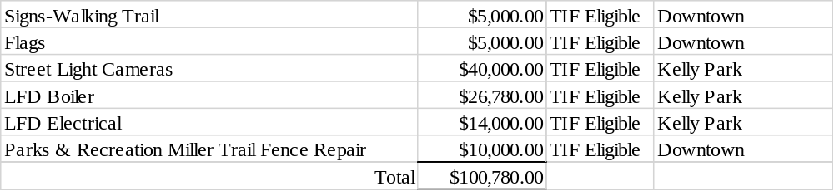
TIF Eligible Capital Improvements
Capital Improvements:
During the budget process, it was discussed to have the following capital improvement items to come out of the designated TIFs.

Slide 13
Questions?

