Slide 1
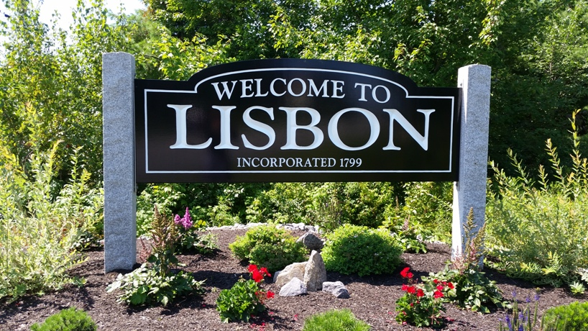
Town of Lisbon
Presentation of the Proposed FY2023 Budget
Ryan McGee, Interim Town Manager
Kayla Tierney, Finance Director

Slide 2

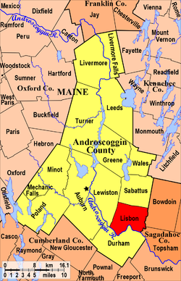
About the Town of Lisbon
The Town of Lisbon is the third largest community in Androscoggin County
Out of 492 communities, Lisbon is the 23rd largest
Based on the Census data from April 1, 2020:
  Population of 9,711
    Highest population since the Town was incorporated
Our Town is growing!
Notes:
Looking at the 2010 Census Report, the Town of Lisbon had a population of 9,009 people, 3,696 households and 2,477 families living in town. In comparison, the 2020 Census is showing a growth of 702 people for a total population of 9,711; 3,728 households. Some other interesting statistics from the 2020 Census are as follows: the median age is 38.9; 14.6%, or 987 of the population are veterans; 8.5% persons below the poverty line; the average travel time to work is 26.6 minutes for residents of our Town, where 2% of the residents work from home.; the median value of owner-occupied housing units for valuation purposes is $150,700; and the median household income is $57,568 which is about 10% higher than the median household income for Androscoggin County.

Slide 3
Budget Components
The proposed Managerial FY 2023 Municipal Budget is for expenditures on an Organizational Level; preliminary revenue figures will be highlighted but will be focused on in more detail at a later date. Each Organizational level includes multiple departments within the Town of Lisbon.
Organizational Levels within the General Fund include:
General Government
Health & Welfare
Public Safety
Public Works
Culture & Recreation
Economic Development
Intergovernmental
Other organizational levels include:
  Debt Service
  Sewer

Slide 4
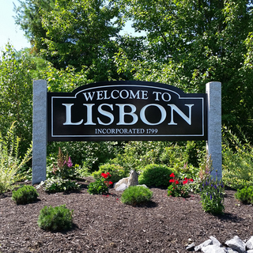
Town Services
Public Safety
  Fire Department
  Police/ACO
  Communication Center
  Ambulatory Services
  Transfer Station
  Library
    Programs offered for all ages
    Summer Reading Programs
  Parks & Recreation
    Summer Camp programs
    Sports Camps
    Before and After School
    Senior Programs
    Beaver Park (300 acre park with beautiful trails and ponds)
    Trips for Seniors and Children
Winter Operations
  Plowing
  Public Works
  Road Repairs
  DARE
    School Resource Officer
  General Assistance
    Giving Tree – Christmas
    Thanksgiving dinner
  Sewer Department
  Tax Collection
    Motor Vehicle Registration
  Code Enforcement
  Clerk
  Assessing
  Finance
  Town Manager
Notes:
At this time, we would like to highlight some of the services that our Town provides to the residents; each department listed works very hard to make each of these programs successful.

Slide 5
FY23 Budget Challenges
Employee Retention and Recruitment
Vacant Job positions
  Filling the Gap – moving towards being fully staffed; not having singular employees holding multiple titles/hats
  COVID-19
  Supply and Demand
    Manufacturing timelines
    Price increases on goods
Notes:
The Town of Lisbon has been experiencing the ‘revolving door effect’. We have been seeing an increase in employee turnover by a drastic amount in this fiscal year. In order to set us up for success into a new fiscal year, it is important to look at employee retention and recruitment. CMA, a third party consulting firm that focuses on this topic, has been hired during FY22 to help the Town by conducting a market study. As indicated in their presentation tonight, the development of a pay structure will aid us in aligning with market data and to work on employee retention and recruitment. COVID-19 still dramatically effects our way of life; the aftermath of this will be felt for many years. We are seeing a 5-7% price increase on most goods and services. In addition, manufacturing timelines are being increased for multiple reasons (staff shortages, overseas delays, material shortages, etc.) Estimated timeline for trucks are at 18 months currently. Based on these current projections, some fixed asset purchases would need to be deferred to FY24 based on timeline alone.

Slide 6
FY23 Solutions
CMA was contracted to perform a Town-wide pay study. Job descriptions and hourly wages/salary amounts were provided to CMA
  Based on their presentation tonight, we still have some work ahead of us in this next few months to propose a pay scale structure
  Incremental – 3 fiscal years
    The increase to salaries and benefits will be over a 3 year period
    Initial year FY23 will have the offset to a current asset account to bring all salaries/wages to the recommended market value pay structure as presented by CMA

Slide 7
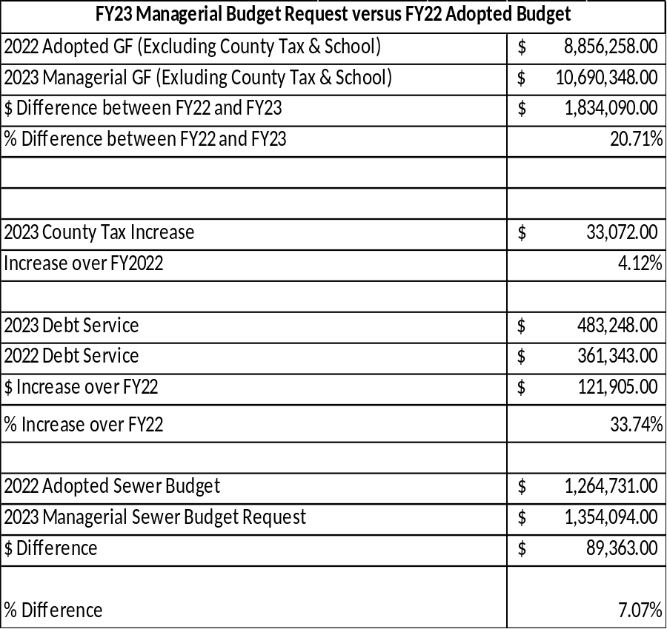
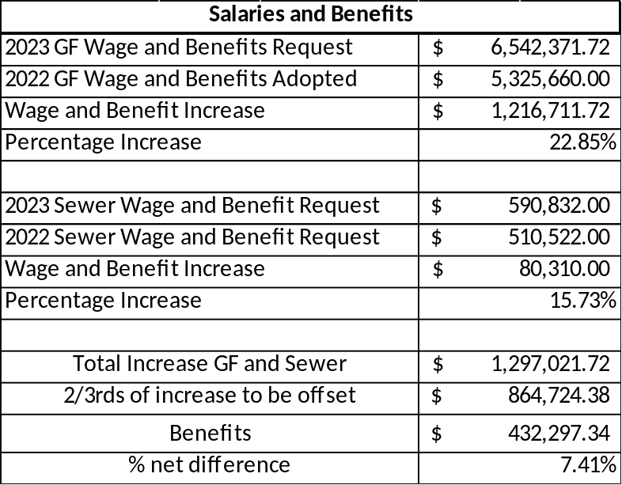
Impacts in Expenditures
FY23 Budget vs FY22 Budget

Slide 8
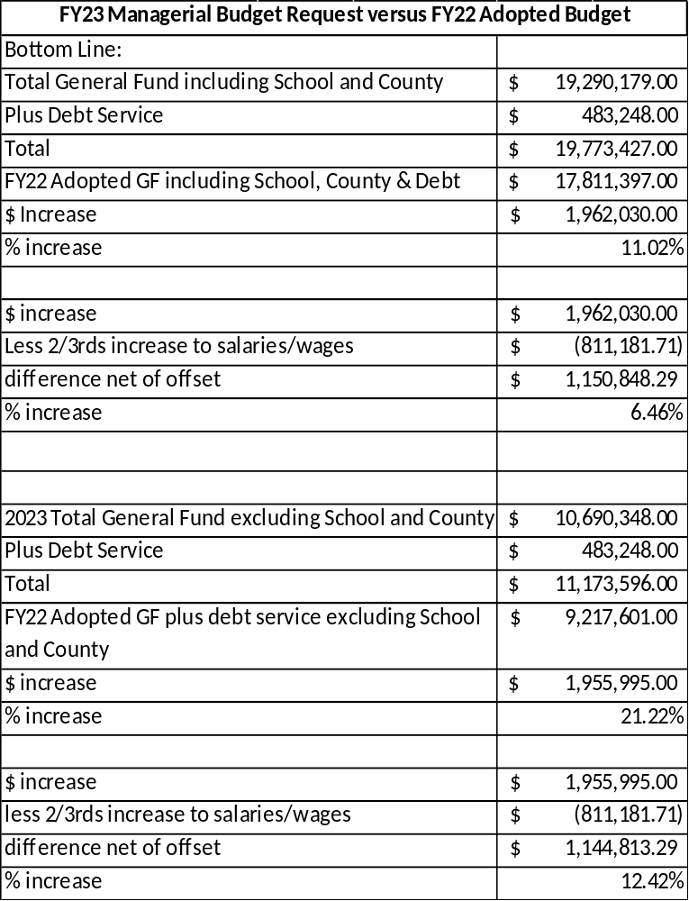
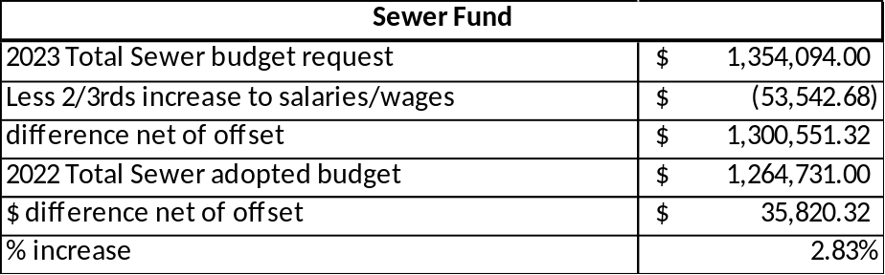
Impacts in Expenditures
FY23 Budget vs FY22 Budget Cont.
Total General Fund FY23: $10,690,348.00
Debt Service: $483,248.00
County: $33,072.00

Slide 9
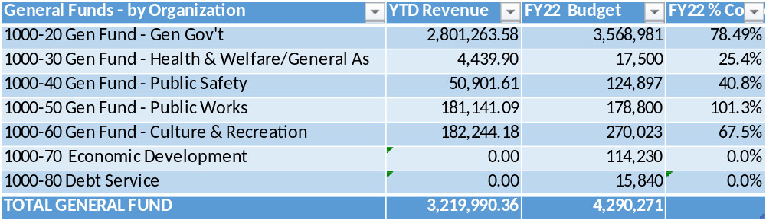
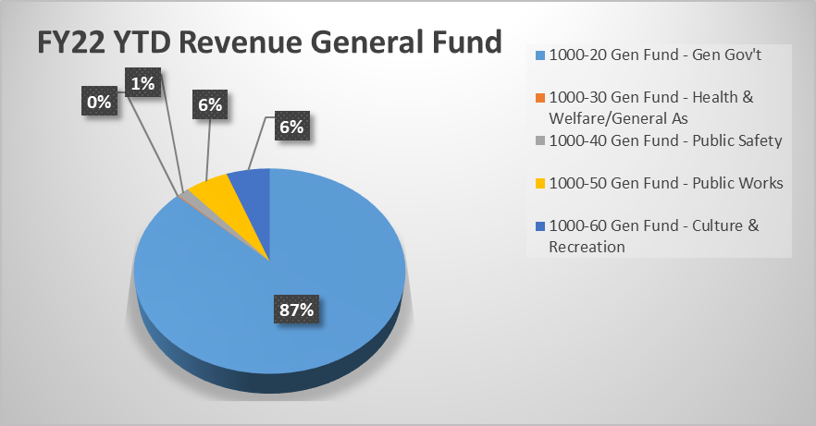
Impacts in Revenues
FY23 Budget vs FY22 Budget
FY22 Revenues
  GF Budgeted $4,290,271.00
  As of 3/15/2022 (data to the right), collected $3,219,990.36 or 75%
  What makes up most of our Revenue?
    General Government – makes up 87% of our current YTD amount.
Notes:
What is included in General Government Revenue? Well, this includes motor vehicle excise tax revenue, boat excise taxes, State Revenue Sharing, Homestead Exemptions and BETE Reimbursements from the State. It also includes revenue from some departments such as Planning Board, Clerk and Code Enforcement. Under Health & Welfare/General Assistance, we have General Assistance (70% of GA expenses are reimbursed by the State). Public Safety revenue is sourced from the following departments: Police, Fire, ACO and Communication Center. Public Works revenue comes from the Transfer Station. Culture & Recreation revenue comes from the Library Department and the Parks & Recreation Department.

Slide 10
Budgeted Property Mil Rate
Town FY22 and FY23
Preliminary FY23 Budget – Revenues:
Based on the projections published this afternoon 3/15/2022 on the State of Maine website, Revenue Sharing for FY23 is showing an $855,912.84 increase from FY22
  State Revenue Sharing for Lisbon = $2,225,912.84

Slide 11
SUMMARY: Mil Rate Impact
What does this mean for Lisbon?
Original proposed numbers was looking at a 1.5 mil increase
Now learning about the Revenue Sharing this afternoon, this can drop that down to a 1 mil increase
This will bring us back to the same mil as FY21
Based on the 2020 Census, on a median household valuation in Lisbon, a 1 mil increase would be approximately $150.
Notes:
150,700 x .02310 = $3,481.17
150,700 x 0.02210 = $3,330.47
$3,481.17-3,330.47 = 150.70

Slide 12
Our Senior Citizens
Senior Citizen Tax Relief Program
  Looking at using a current asset account to help support and fund the program
  What would this look like, you may ask…
  We respectfully ask the Town Council to task the Town Manager and Finance Director to work with the Finance Committee at researching to implement this program for our senior citizens.

Slide 13
Fund Balance Policy
Sec. 86-1. - Fund balance policy.
(a) The Town of Lisbon recognizes the importance of maintaining an appropriate level of undesignated fund balance. The town's unassigned GF fund balance serves a number of stabilizing purposes. It is a surplus of amounts which have accrued from unexpected operating budget surplus and unanticipated excess revenues. The surplus also provides the town with an amount for use in unforeseen, unbudgeted emergency situations, and provides a cash flow cushion to offset the need for borrowing in anticipation of tax receipts.
(b) In order to maintain financial stability, the town has established this policy to maintain an unassigned GF fund balance no less than 12% and no more than 16% of the current fiscal year's budget as defined below:
Gross town operating budget, including town's share of school budget, town's portion of the county's operating budget, and debt service.
(c) Once the town achieves its goal of an appropriate level of undesignated fund balance, any excess funds may be utilized for other municipal purposes, including, without limitation, additional capital improvement needs, tax rate stabilization, or reduction purposes. For example, by utilizing excess fund balances for capital improvements, the town will reduce the need to incur long-term debt and will avoid creating an operating funding gap for subsequent fiscal years.
(d) This policy has been adopted by the town to recognize the financial importance of a stable and sufficient level of undesignated fund balance. However, the town, reserves the right to appropriate funds from the undesignated fund balance for emergencies and other requirements the town believes to be in the best interest of the town.
(e) In the event the town's undesignated fund balance drops below the 12% minimum, a written plan to replenish the fund within a maximum of three fiscal years must be approved by the town council at the time of the emergency GF fund balance appropriation.
(Sel. Ord. of 2-7-2006, § 5.166; C.M. of 3-7-2017, V. 2017-51 )

Slide 14
Use of Unassigned Fund Balance
As of 06/30/2021, the Unassigned Fund Balance based on the audited financial statements is: $3,463,099.00. Per Town Charter, 12% of the fund balance is to be retained, or $1,331,335.48. In looking at the fund balance, it is important to keep in mind the amount designated during the FY22 budget adoption, as this is to be subtracted from the above number; after doing so, it will leave $675,999.62. The following capital assets are being requested to be funded through unassigned fund balance during FY23.
$145,000 Tractor Trailer for the Solid Waste Department
$50,000 1 ton truck for the Parks & Recreation Department
$14,127 ongoing Clerk Book Restoration project
$16,000 PD Firearm 10 Year Replacement Program
$450,000 Salt Shed (re-designated from FY22)

Slide 15
Capital Improvement Plan
The Capital Improvement Plan (CIP) is a document that focuses on the implementation of community goals through detailed recommendations on capital spending and needs for the current and forecasted fiscal years.
The CIP to be submitted to the Council is to be broken down by Town and presented here on a departmental level
This plan is presented on a 5 year model and on a 10 year model

Slide 16
About the Plan
The CIP demonstrates specific projects, amounts of those projects, and the sources of funding for those projects.
This document is a framework for making the best use of financial resources.
Within the CIP report, a section of footnotes follows immediately after department’s requests. These footnotes go into more depth about the capital items being requested in the upcoming fiscal year.
In addition to the 5 and 10 year plan forecasts, this report includes estimated annual cost of operating and maintaining vehicles and equipment, as well as the current mileage of those vehicles
The Debt Structure (Bonds and Leases) is also included in this report
Each department has submitted their requests for capital needs

Slide 17
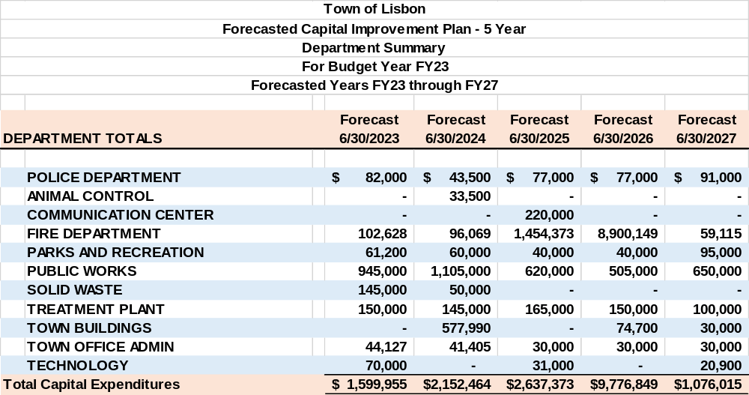
Town of Lisbon Summary – 5 Year CIP

Slide 18
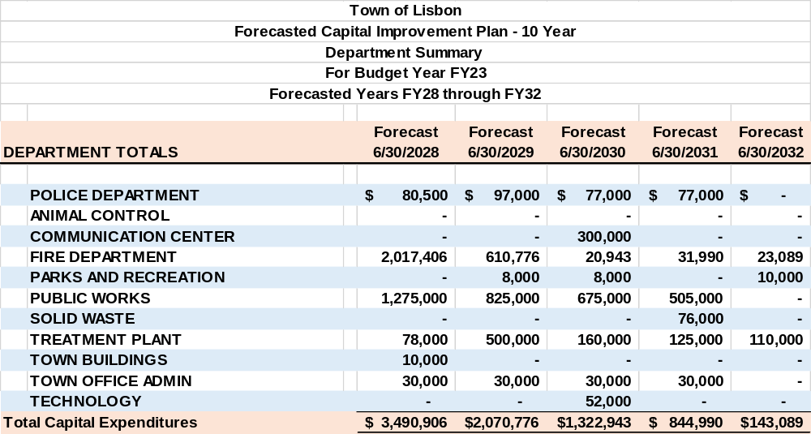
Town of Lisbon Summary – 10 Year CIP

Slide 19
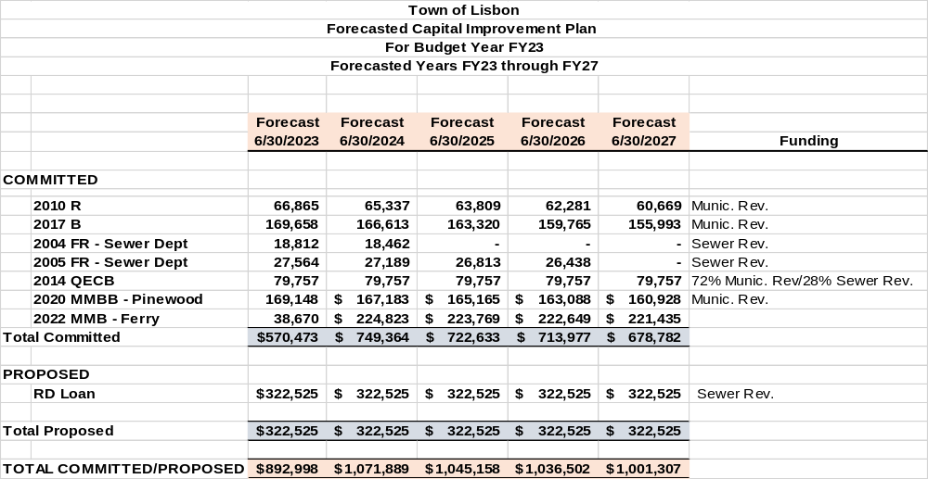
Debt Structure – 5 Year

Slide 20
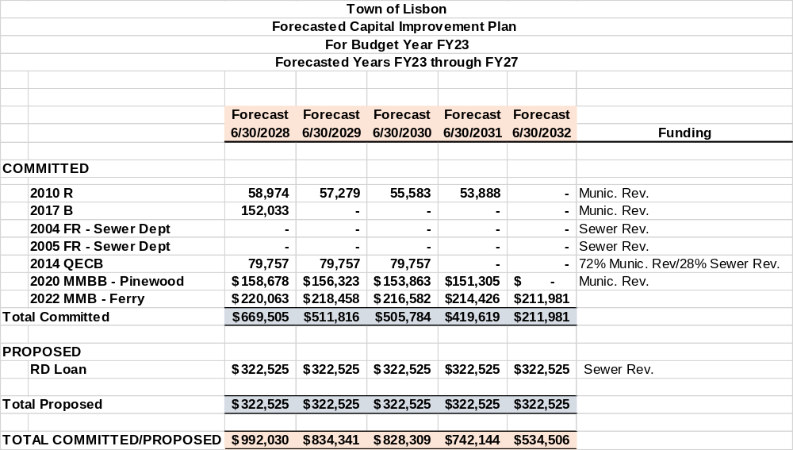
Debt Structure – 10 Year

Slide 21
FY23 CIP Highlight – All Departments
Police:
  The PD Cruiser Replacement Plan replaces (1) Cruiser 1 year and (2) Cruisers the next year. By keeping it at $67,000 per year, it offsets the total cost in the subsequent year. FY23 is a (1) Cruiser replacement year.
  Firearm Replacement - funded through Unassigned Fund Balance.
  Fire:
    Car #4 (2010 pick up truck) – funded through TIF
    Turnout Gear – funded through Municipal Budget
    Hydraulic Rescue Tools – funded through Municipal Budget
Parks & Recreation
  1 Ton Dump Body Truck – funded through unassigned fund balance
  Side by side Utility 4 Wheeler – funded through Municipal Budget
  Public Works
    Salt Shed – re-designate fund balance from FY22 to FY23
    Annual Paving – funded through Municipal Budget
    Guardrail repairs – funded through Municipal Budget
    Sidewalks – funded through Municipal Budget
    Gasoline Tank and Pump replacement – funded through Municipal Budget

Slide 22
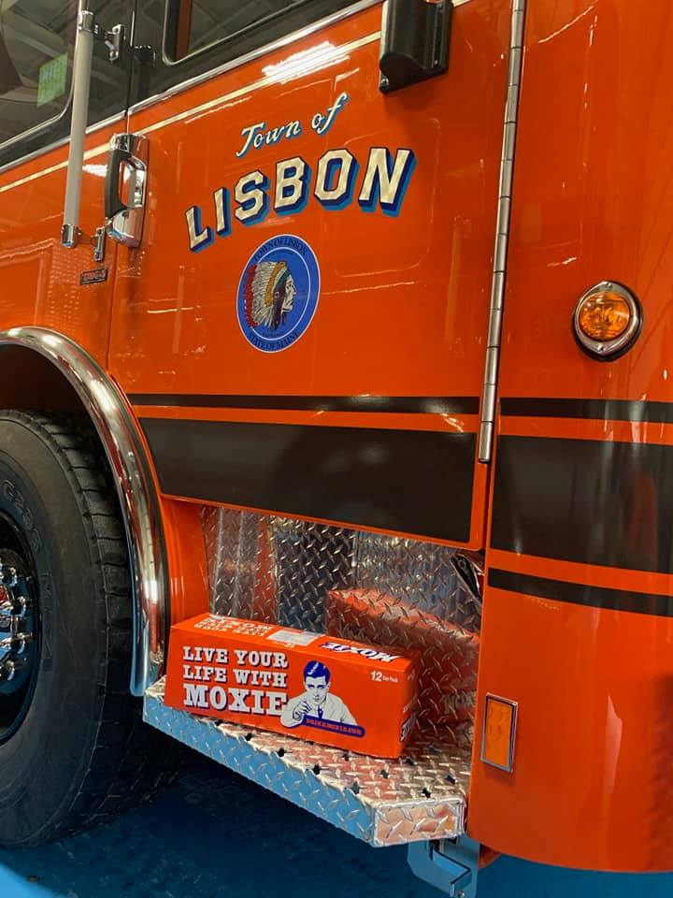
FY23 CIP Highlights – All Departments Cont.
Solid Waste:
  Tractor Trailer – funded through unassigned fund balance
  Treatment Plant:
    Freightliner FL80 – funded through Sewer Budget
    75KW Onan Generator – Portable – funded through Sewer Budget
    Polymer feed system – funded through Sewer Budget
    Eimco Clarifier Rehab – funded trough Sewer Budget

Slide 23
Questions?

